Slide 1
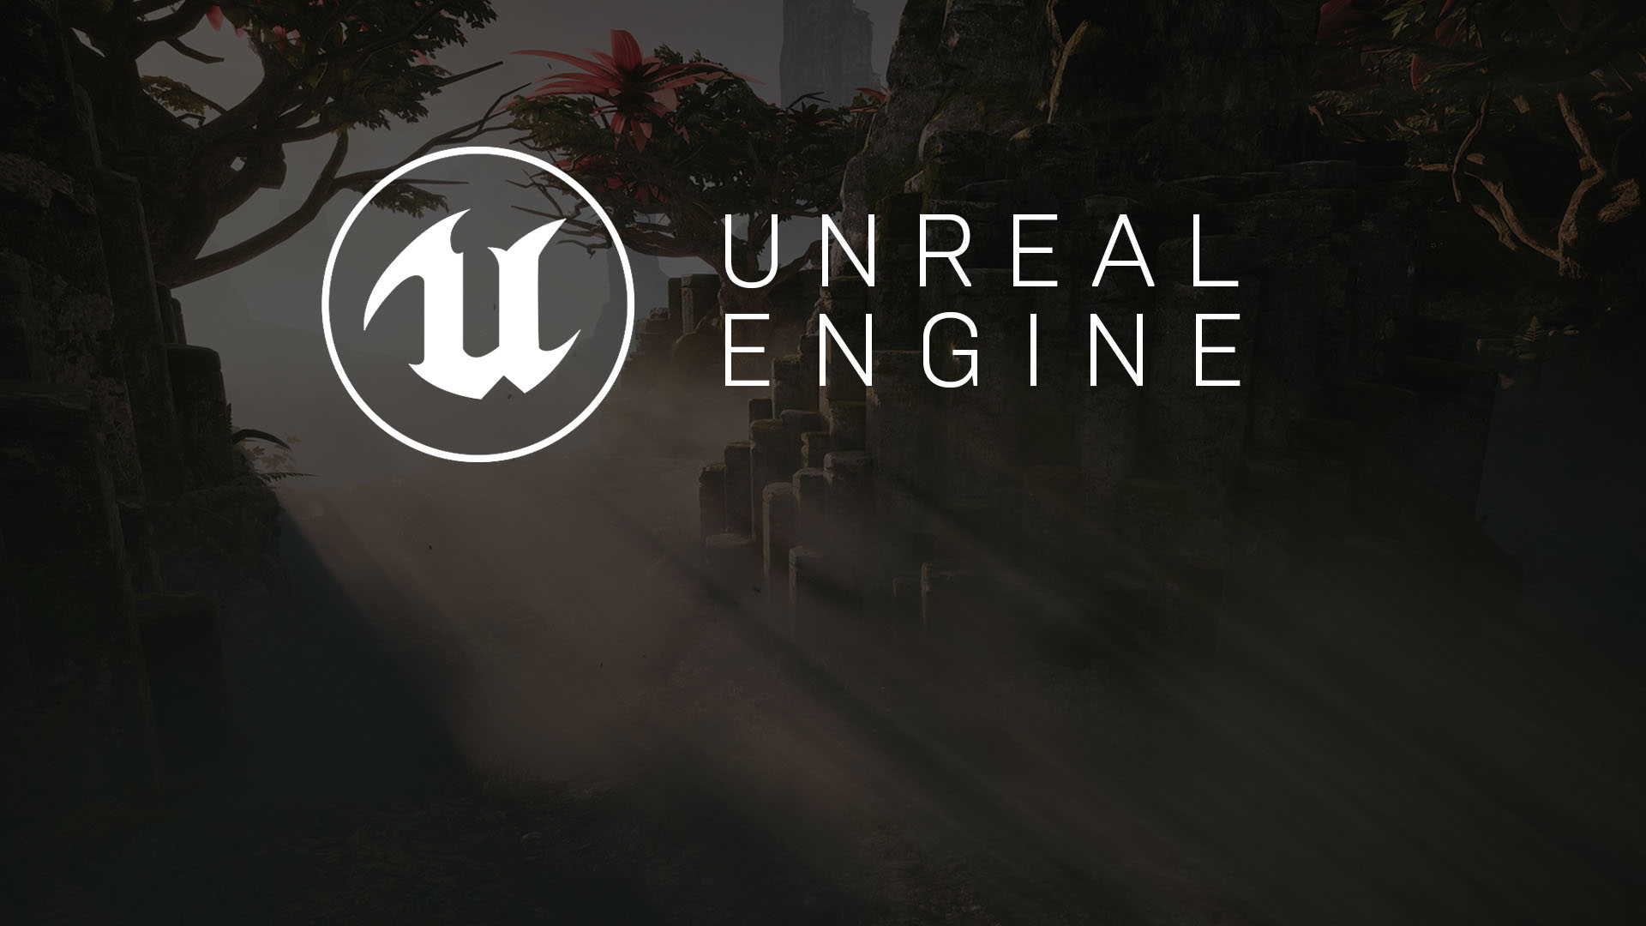
WEEK #11
User Interfaces
Relaying Information to the Player

Slide 2
FINAL PROJECT INFO
2 Progress Interviews (10% each = 20% + 20% Final Presentation)
If you are a team of 2, both students must be present during the interview. If you have an emergency, that’s of course debatable.

Slide 3
ROADMAP
We meet at class hours (Tuesdays) to talk about your final projects!
#12 / 20th December 2022 - Progress Interviews #1
#13 / 27th December 2022 - Progress Interviews #1/#2
#14 / 3rd January 2023 - Progress Interviews #2
17th January 2023 FINAL PRESENTATIONS

Slide 4
PROGRESS MEETINGS
Bring your laptop at the current state. (If you don’t have a laptop just upload the project files to the lab computer and make sure it’s running without a problem before the meeting starts.)
Make sure everything on Hack’n Plan is up to date and reflects the current state of the game.
Then you will demonstrate your progress on your laptop face-to-face. I’ll compare it with Hack’n Plan.
I’ll check your Hack’n Plan and Check Review Sub-Tasks!!!
You will get graded based on your development progress.
Of course, we’ll talk, add new features and tasks to your current game. Development is a fully-dynamic process!
Good luck!

Slide 5
FINAL PROJECT REQUIREMENTS
Your game must have a main menu.
It should be available to be played from start to finish: No missing mechanics or features!
No game-breaking bugs!
Any player should be able to play it with the instructions displayed in the game. So any simple tutorial levels or visual representations are very welcome! (For instance, you can display inputs on the walls, screen ..etc)
You don’t need to add a lot of levels but enough levels to show your mechanics are working!
You are free to use store assets or your own ones! Implementation of mechanics based on your submission documents and presenting a reasonable gameplay with map elements are taken into account while grading.
It would be very time-saving to implement some cheat keys to showcase your game. Like skipping maps or teleporting into a next location...etc Because your team will going to have 5 mins for the presentation.

Slide 6
GRADING AND EVALUATION
*Midterm | You will be given 2 assignments.Their average score will be counted as your midterm score. | 100 | 30
*Lab/Home-works | You will be asked to build several tasks with the topics covered in the courses. | 100 | 30
*Final Project | You will be asked to build a complete game project with a team of maximum 2 people. (Solo teams are also accepted.) You are required to show weekly process of your project by coming to the practice sessions. And the whole project will be evaluated based on the items which will be explained later. | 100 | 40
TOTAL |  | 100 | 100

Slide 7
GRADE SCALE
Grade Range | Letter Equivalent
95-100 | A
90-94 | A-
85-89 | B+
80-84 | B
75-79 | B-
70-74 | C+
65-69 | C
60-64 | C-
55-59 | D+
50-54 | D
0-49 | F

Slide 8
PROJECT POINT SYSTEM (COLLECT 25 FOR EACH STUDENT) FOR EVERY FINAL PROJECT THESE ARE REQUIRED!
Code | Description | Points
Q1 | Main Menu | Required
Q2 | Main Playable Map | Required
Q3 | In-Game Tutorial / Input showcase | Required
Q4 | End Game/Victory/Defeat Screen | Required

Slide 9
PROJECT POINT SYSTEM (REQUIRED) CHOOSE UP TO 25 PNTS!
G1 | Multiplayer Implementation | 7
G2 | Enemies (Each Type: Melee,Ranged,Caster) | 3
G3 | Traps (Each) | 1
G4 | Interactable (Doors, Levers..etc) | 1
G5 | Character Creation | 3
G6 | Character Customization | 3
G7 | Attack Action | 2
G8 | Special Action | 2
G9 | Ranged / Cast Action | 2
G10 | Jump / Dash Action | 2
G11 | Climb / Hook Action | 2

Slide 10
PROJECT POINT SYSTEM (MECHANICS) PICK TO ROUND YOUR POINTS TO 25!
M1 | Single Attack causes hit pause. | 1
M2 | Single Attack hits in an area in front of the player. | 1
M3 | Single Attack makes the player auto face the closest opponent. | 1
M4 | Holding Single Attack increases damage. | 1
M5 | Dash target marker. | 1
M6 | Dash teleports through enemies and some objects. | 1
M7 | Special does heavy radial damage. | 1
M8 | Special can not be interrupted by enemy attacks. | 1
M9 | Cast auto targets the closest enemy. | 1
M10 | Enemies turn into ragdolls when slained. | 1
M11 | After slained, a couple of seconds their bodies turn into glowing particles. | 1

Slide 11
PROJECT POINT SYSTEM (RULES) PICK TO ROUND YOUR POINTS TO 25!
R1 | Strength affects weapon damage. | 1
R2 | Agility affects walking speed. | 1
R3 | Intelligence affects mana regeneration rate. | 1
R4 | Endurance stat affects total hitpoints. | 1
R5 | Luck stat affects critical attack chance. | 1
R6 | When stamina is out, player jumps/leaps. | 1
R7 | Cast consumes mana meter. | 1
R8 | Special consumes stamina meter. | 1
R9 | Dash consumes stramina meter. | 1
R10 | Walking drains stamina. | 1
R11 | When stamina is completely drained the player can not run till it regenerates | 1
R12 | Critical chance is used from character creation and causes double damage with red text display. | 1
R13 | Cast may be critical by causing double damage. | 1
R14 | When the players die, they spawn at different spawn points around the map. These are actually spawn points for each player in a multiplayer game. | 1

Slide 12
PROJECT POINT SYSTEM (VISUAL FEATURES) PICK TO ROUND YOUR POINTS TO 25!
V1 | Enemy health bars fade-in when they are close to us. The bars become invisible when they are far from the player. | 2
V2 | Mana and Stamina bars turn grey when there is not enough meter to cast, dash or do special. Pressing corresponding keys will trigger an action-not-ready sound effect. | 2
V3 | There is a log text area for important actions happening during the game. | 2
V4 | Player’s sword has an attached particle system for slashing effect trails. | 1

Slide 13
HACK’N PLAN
How to create a Project!

Slide 14
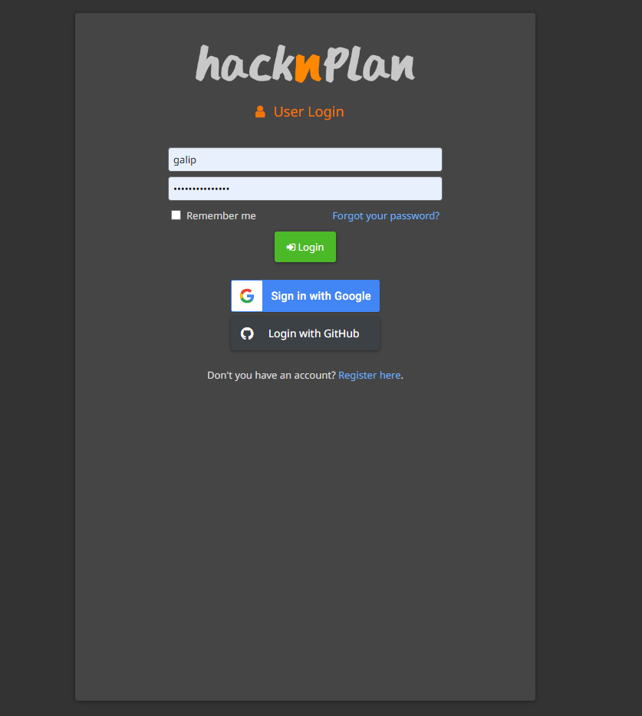
Create a new account
Goto
https://app.hacknplan.com/login
Create a new account!

Slide 15
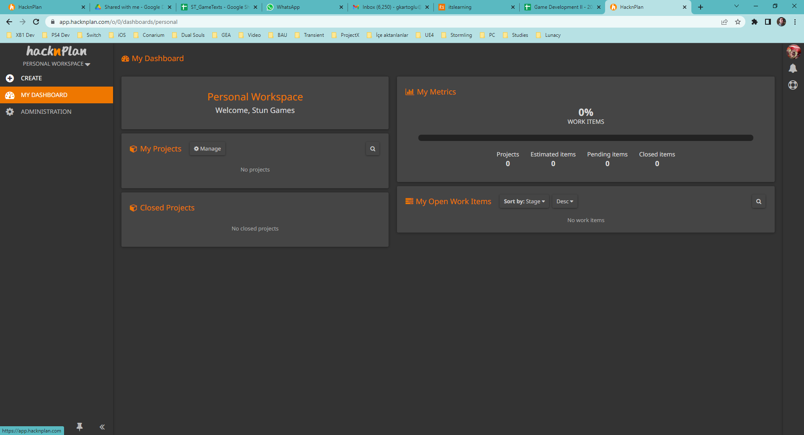
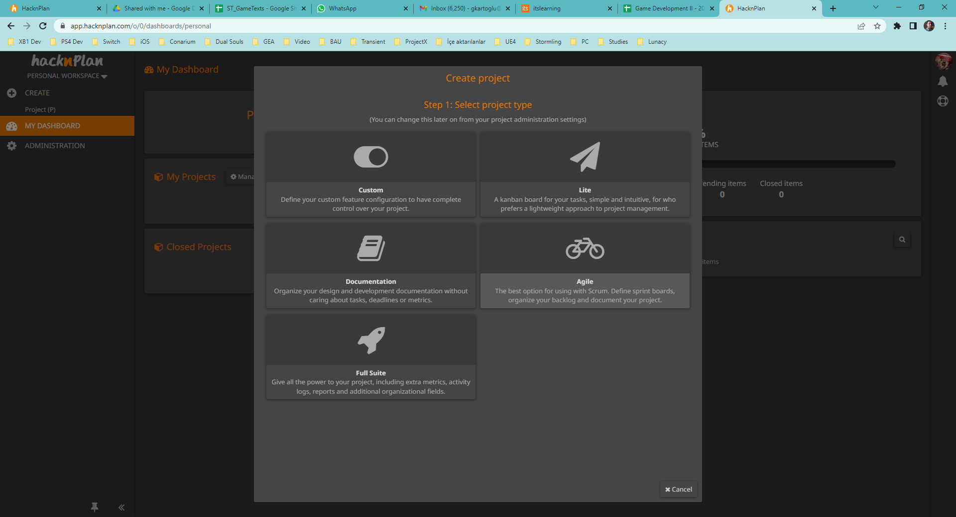
Create / Template
Select «Create»
Select «Agile» Template

Slide 16
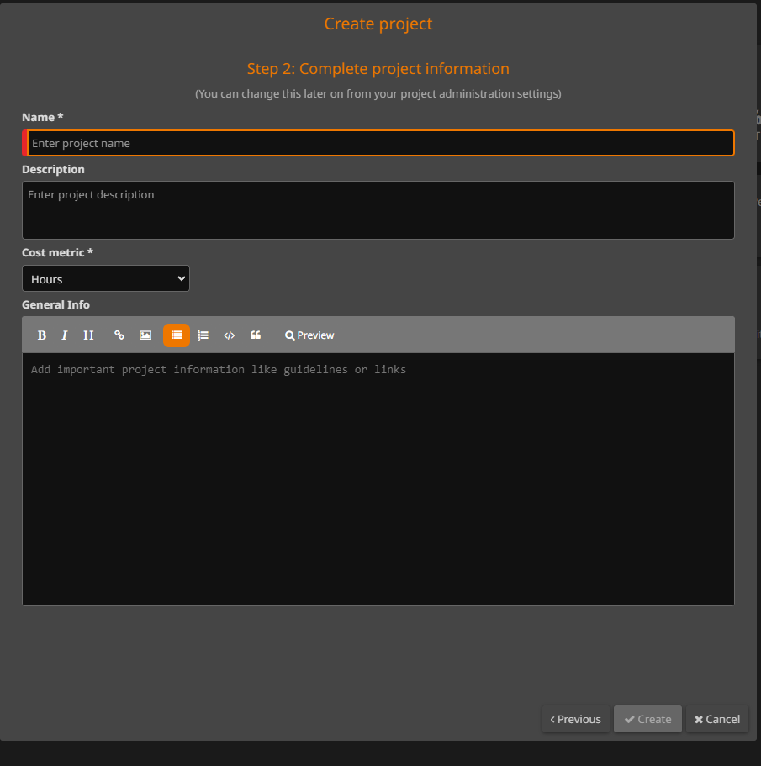
Final Project Details
Fill in your project details.
Name (Required!!!)
Description (Required)
General Info (Options)

Slide 17
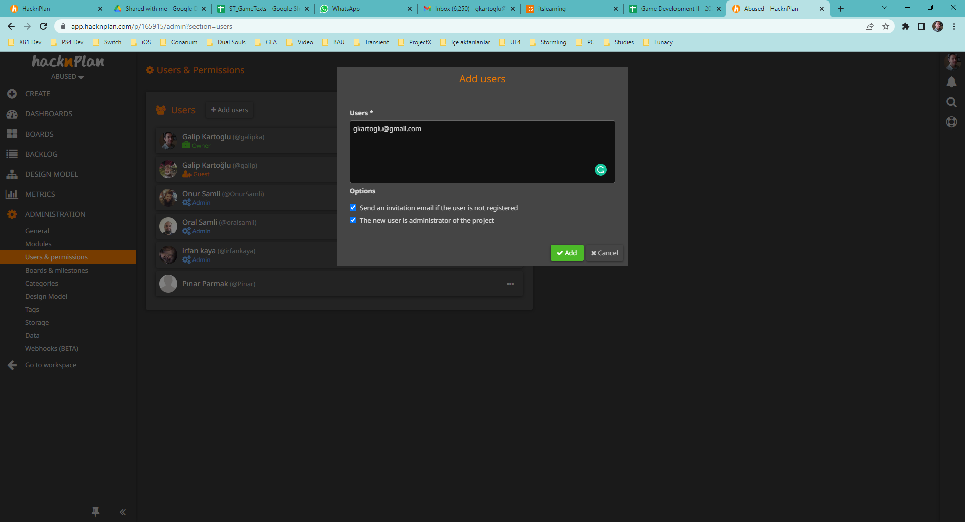
Adding Teams Members and Me!
Goto Administration => Users & Permissions.
Add users to invite your team members.
Invite me as an administrator of the project:
gkartoglu@gmail.com

Slide 18
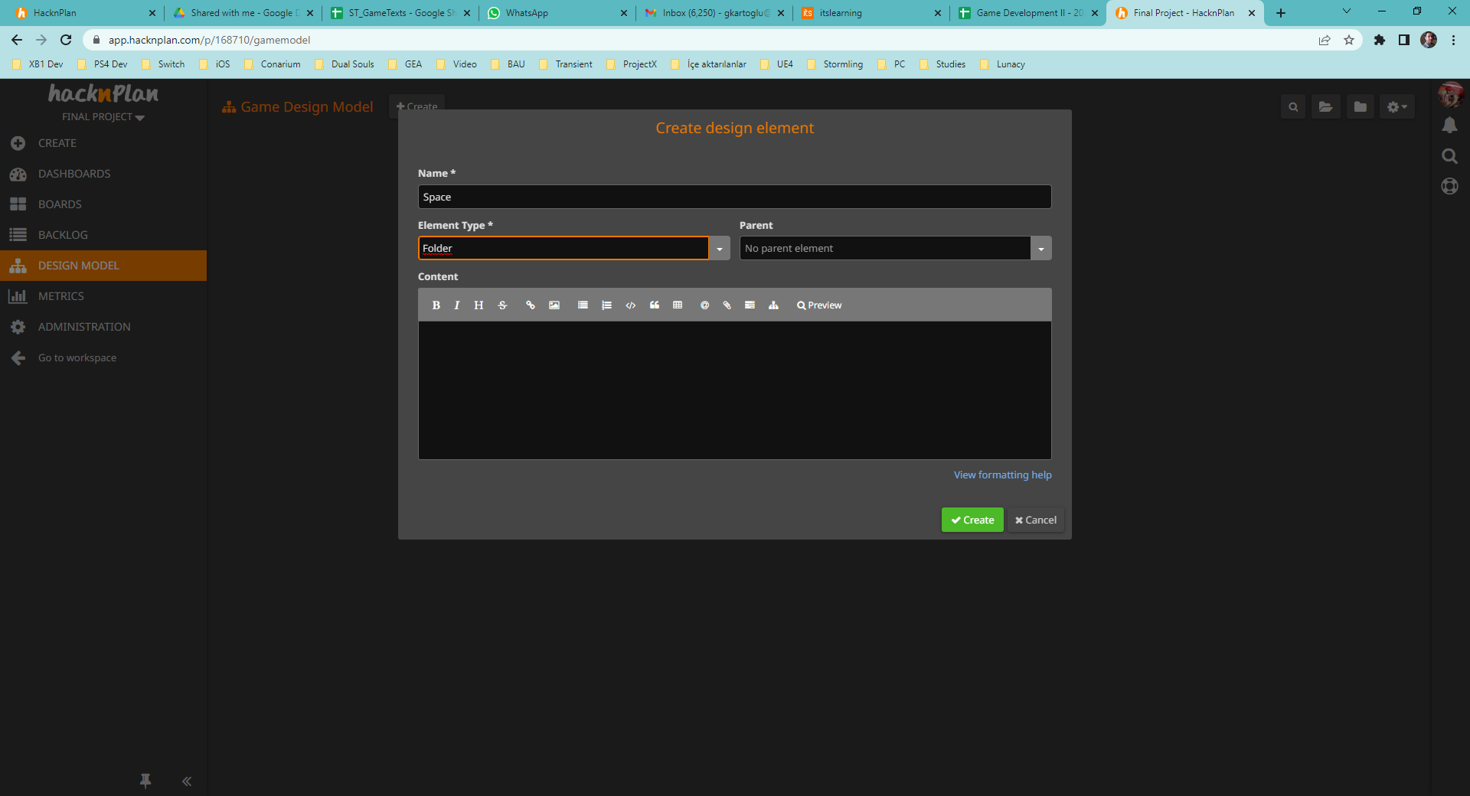
Design Model
Goto «Design Model»
Select Create and add these «Folder»s
Space
Goals
Actors
Mechanics
Rules

Slide 19
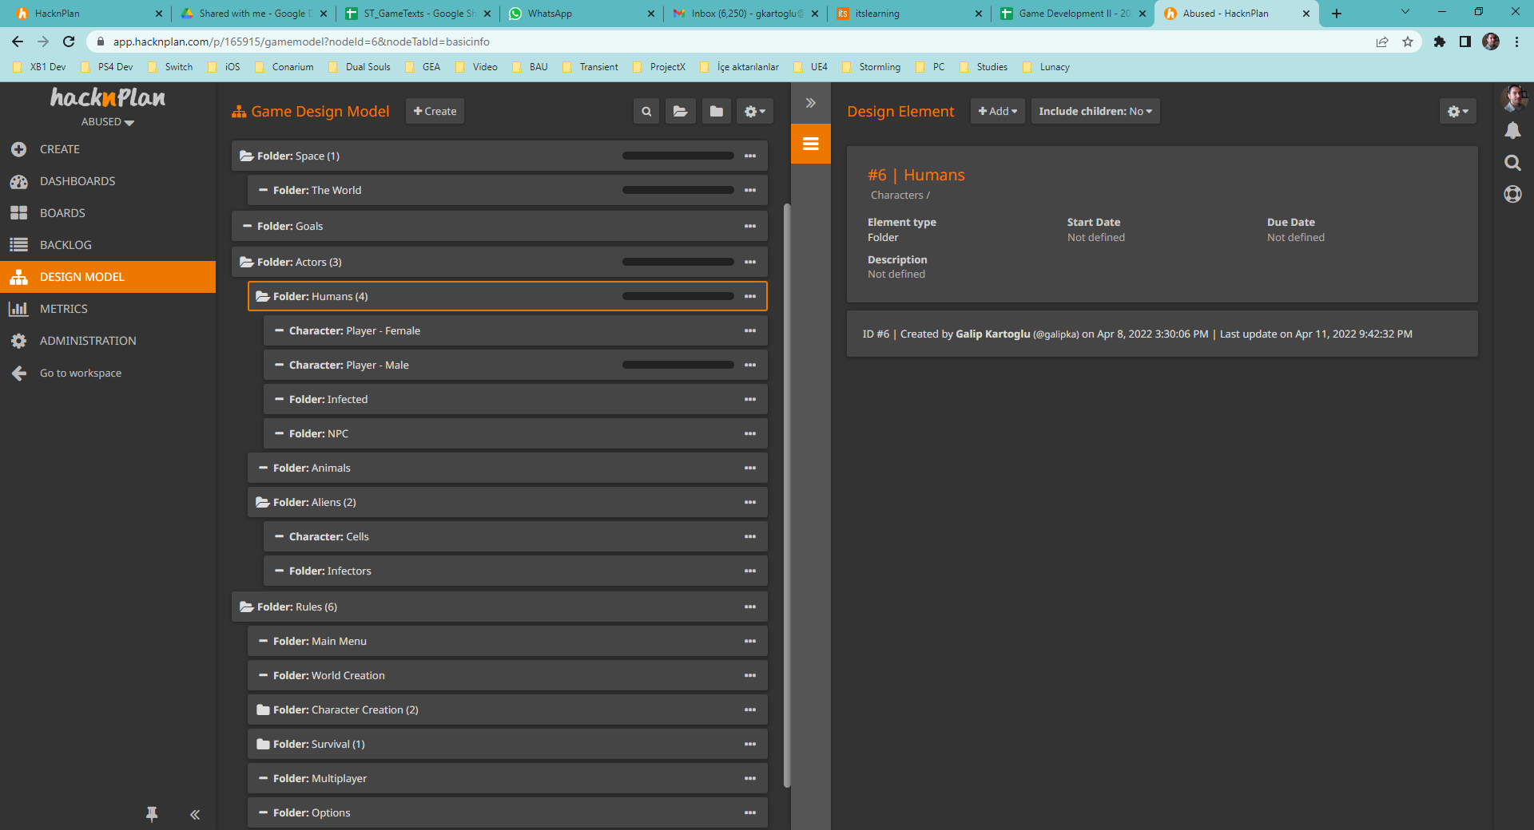
GDD
Add your sub-folders and description.
Maintain your GDD right here in Game Design Model.

Slide 20
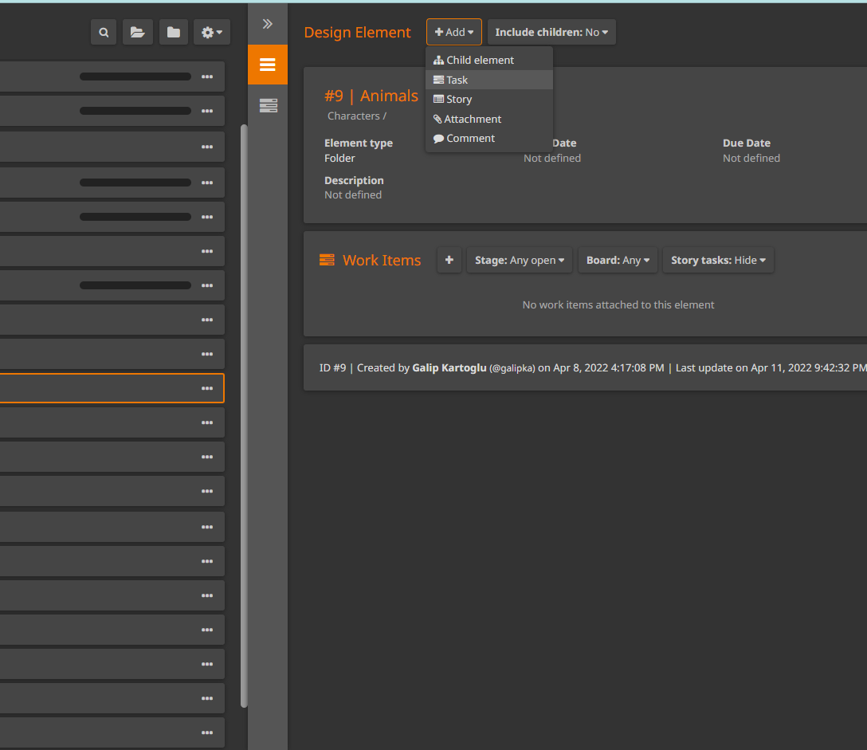
Tasks
- Using «Add Task» button, start adding tasks to team members and fill in «Sprint #1» board.

Slide 21
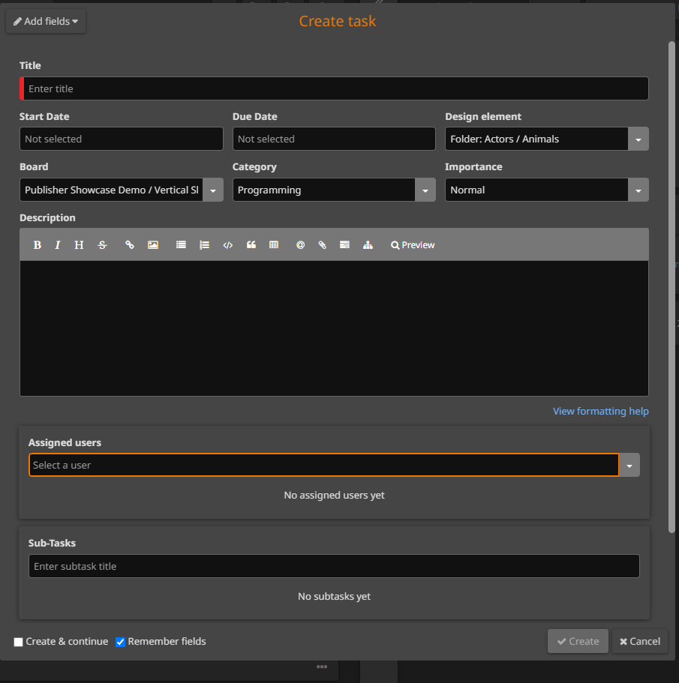
Creating Tasks
Add separate tasks for related «Categories» for each team member.
Set «Due Dates» if possible.
Create «Sub-Tasks» if necessary.

Slide 22
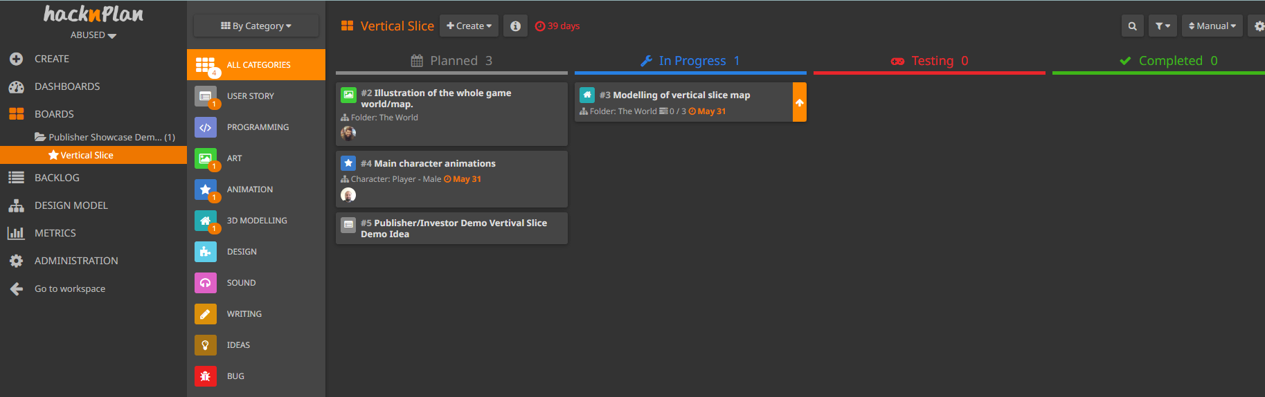
Plan, Code, Test, Complete!
You may have 2+ «Sprints» starting for each interview:
Every week, we’ll meet and you will show me your project progress. Implementations will be checked and based on your progress you will get graded.

Slide 23
UI 101
The Basics

Slide 24
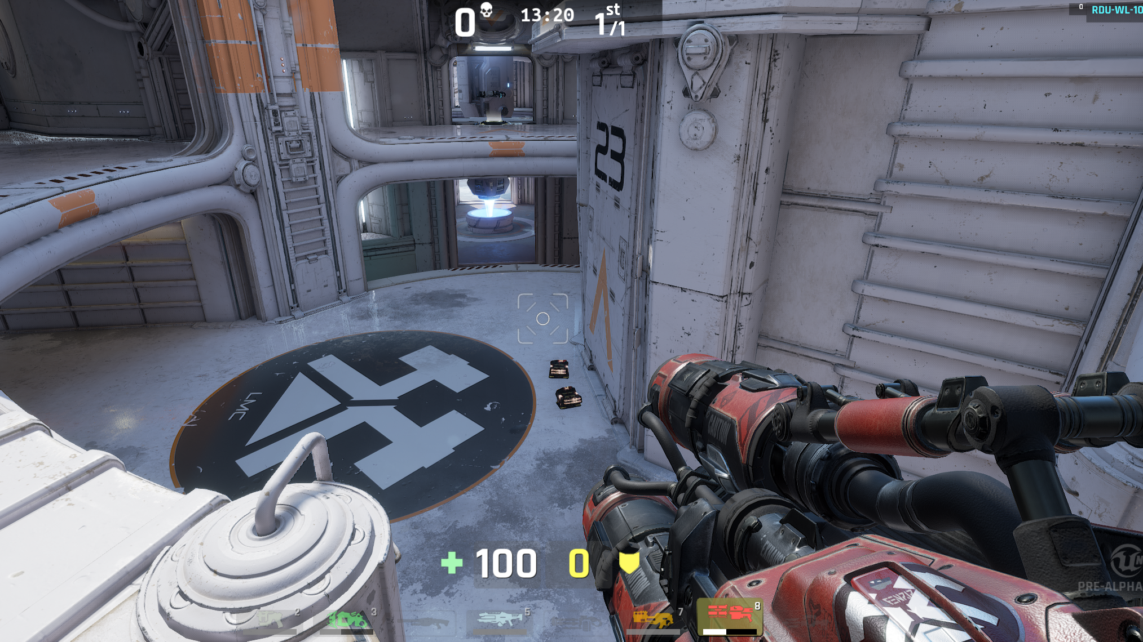

What is a User Interface?
The User Interface of a game is the set of methods and features that allow the player to interact with the game, and the game to provide information to the player. It can include a range of mechanics within the gameplay, input from controllers, menus, and HUDs and utilizes 2D and 3D art, sound, and physical feedback via controllers (rumble, haptic, force feedback).
More often than not, when people discuss User Interface, they are referring to either menus or HUDs. While these are important to most games, remember that other methods exist and in some cases can offer an easier or clearer user experience, or a more immersive experience. A recent trend in game design is to integrate menus and HUDs into the game world and story, a method called Diegetic Interfaces.

Slide 25
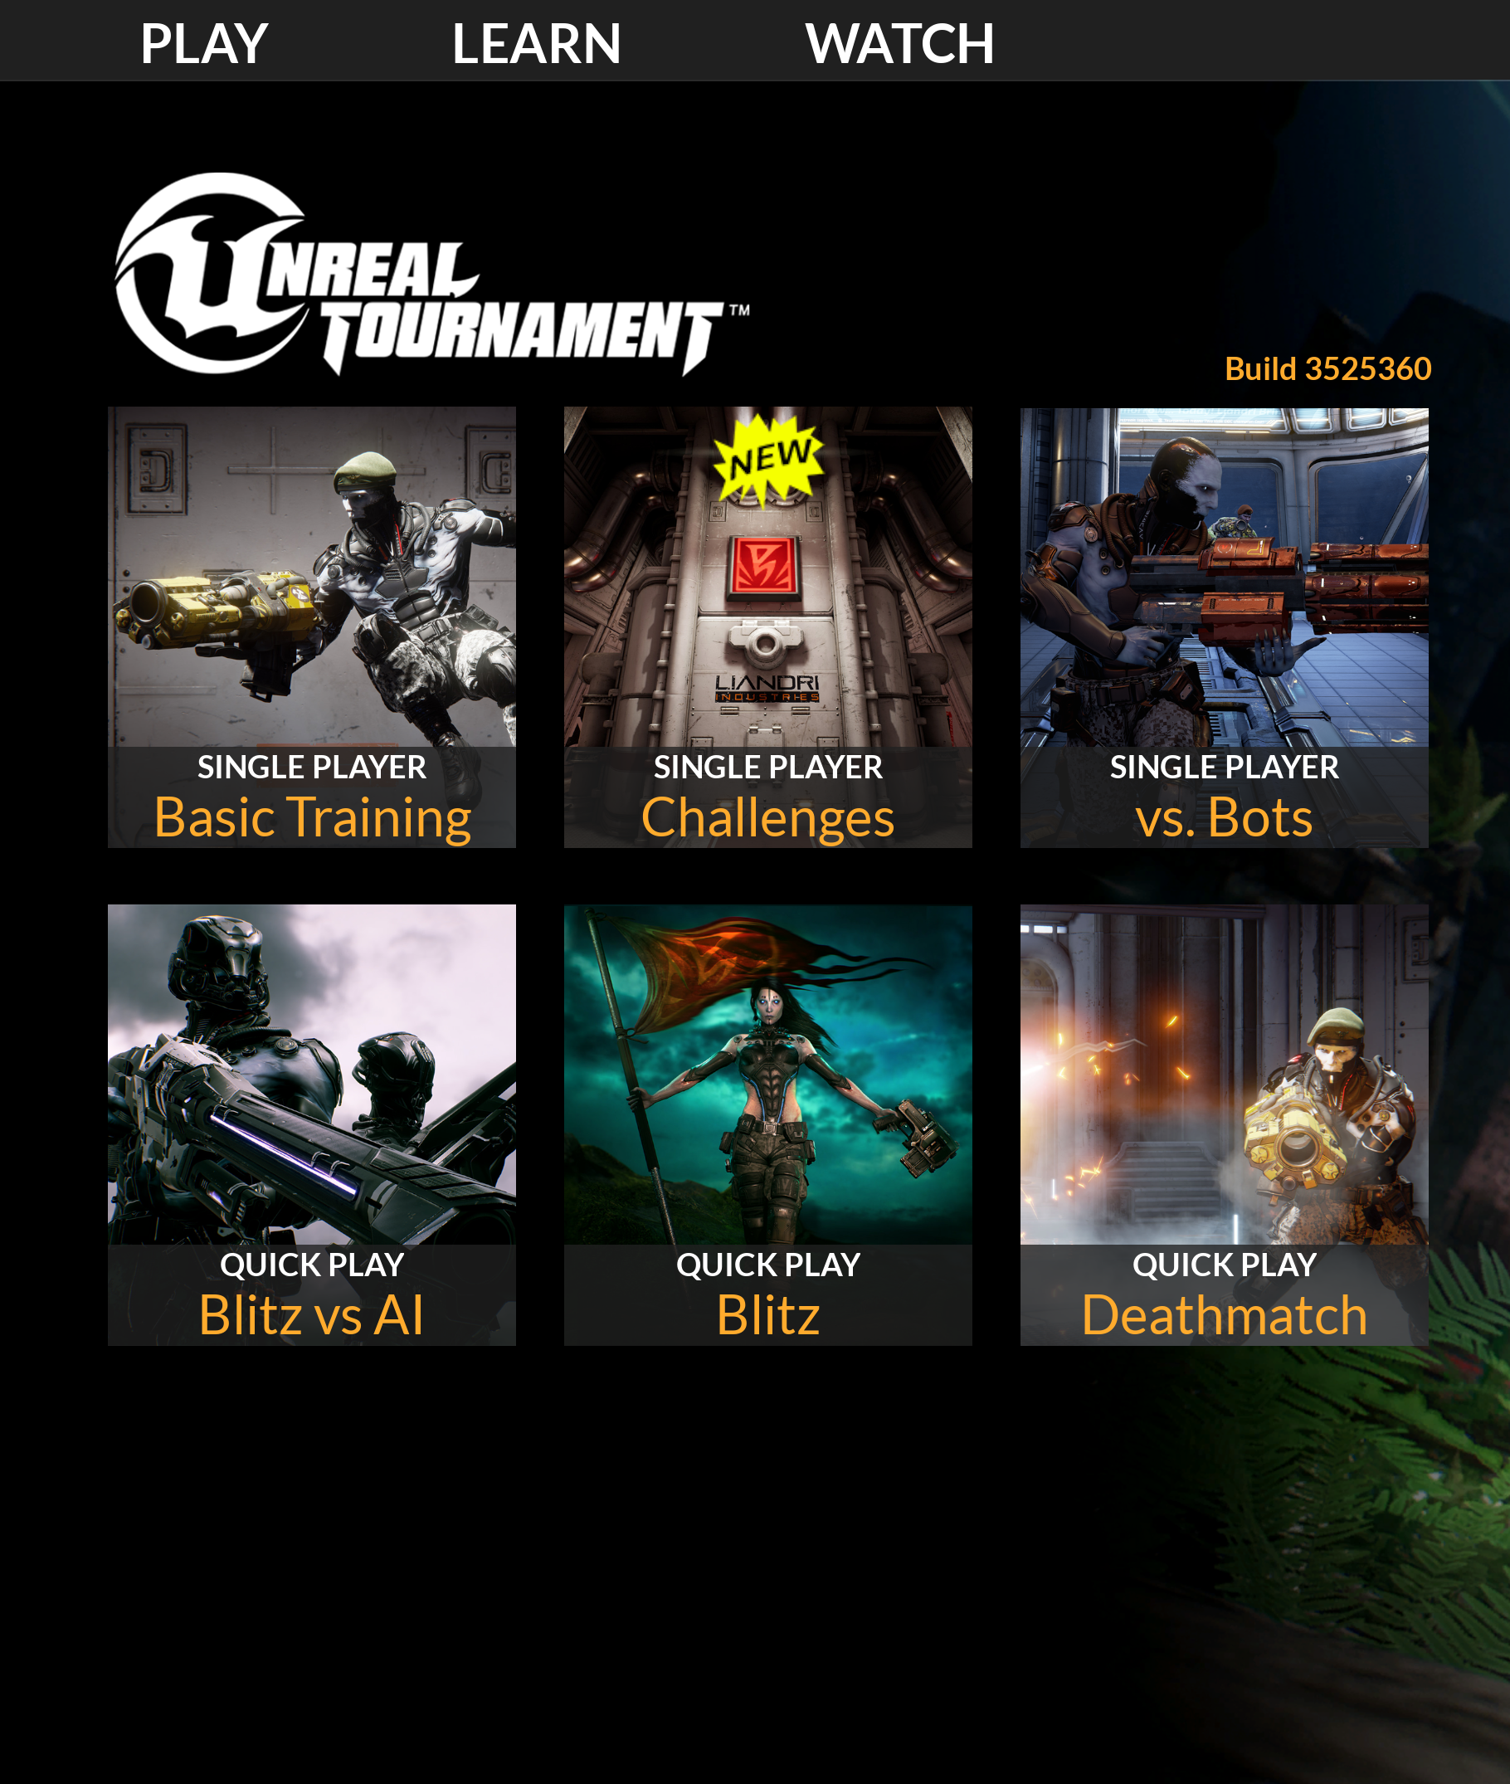
HUDs
A heads-up display, or HUD, is a common method of displaying important game information to players.
Menus
Menus are interactive interfaces that commonly allow players to move between different game states or set various configuration options.
Item Information
Assets within the world often need to convey information back to the player (for example, how long until the item respawns).
Interactive World Items
Systems such as locks, computer terminals, and conversation dialogue require separate user interface elements to work within the world. These are often driven through the same tools used to create screen user interfaces.

Slide 26
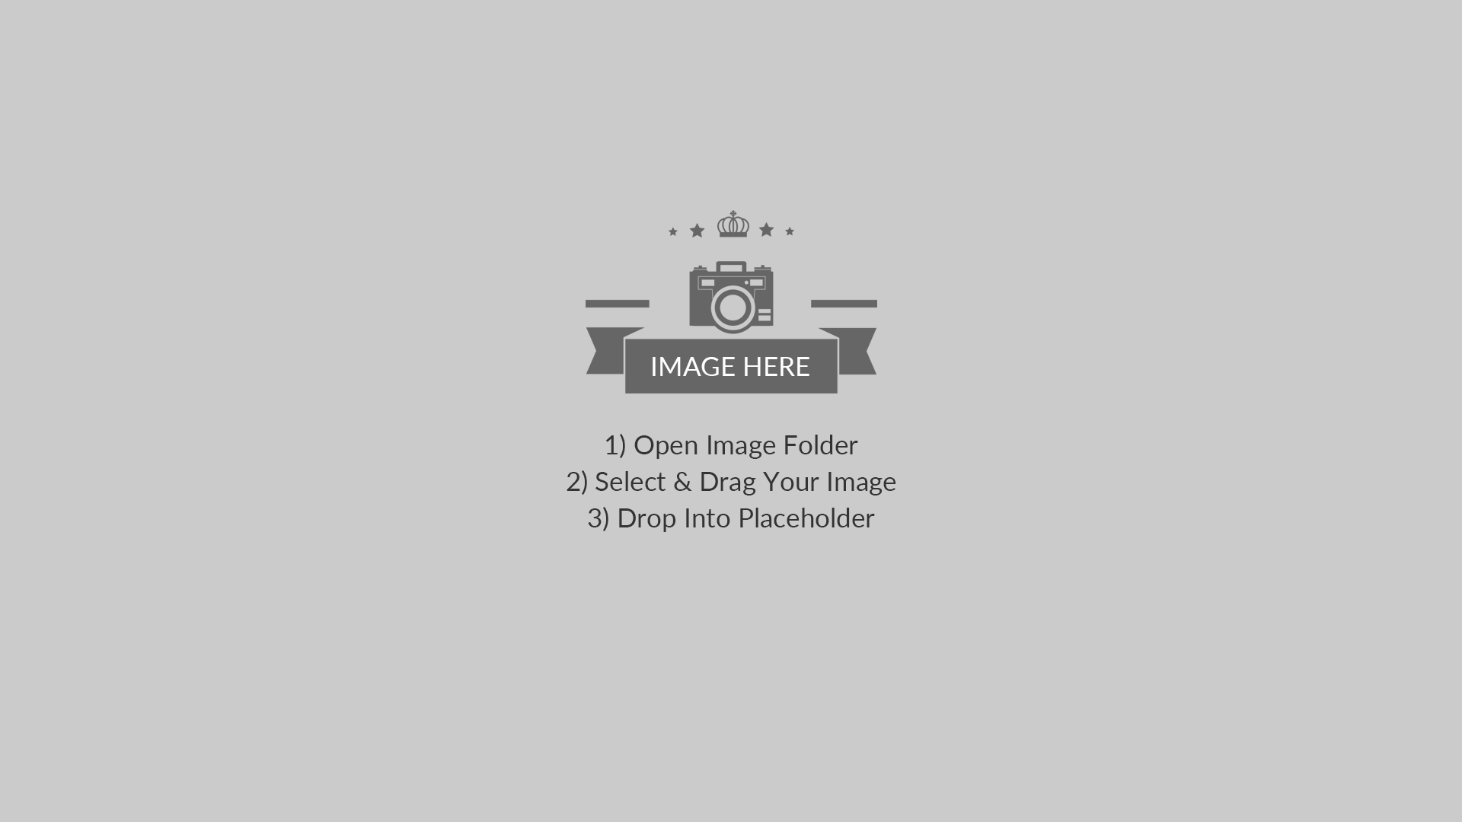

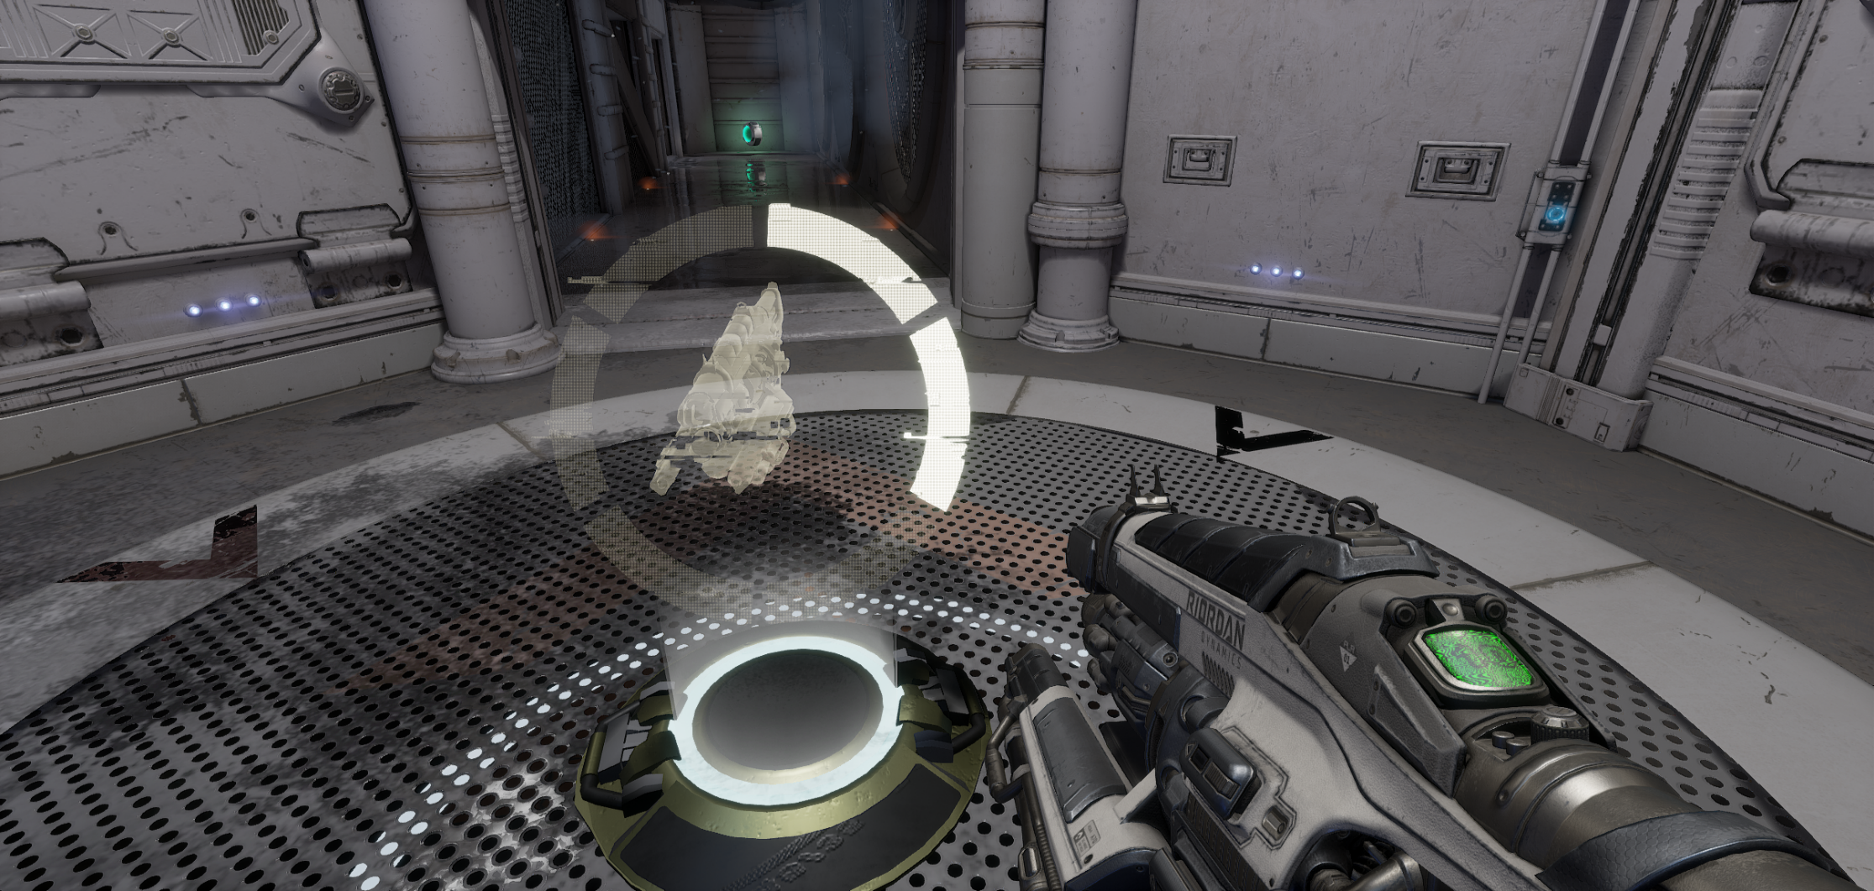
Unreal Tournament HUD
Weapon pickups in Unreal Tournament
Screen UI
World UI
User Interface elements are typically projected directly to the player’s viewport or screen as 2D elements. In the above example, we can see a game HUD with available weapons, health, armor, and other gameplay information.
Sometimes UI elements are built into the world. In this example, the time until the weapon respawns is displayed as a UI element on the weapon factory.

Slide 27
UMG
Unreal Motion Graphics UI Designer

Slide 28
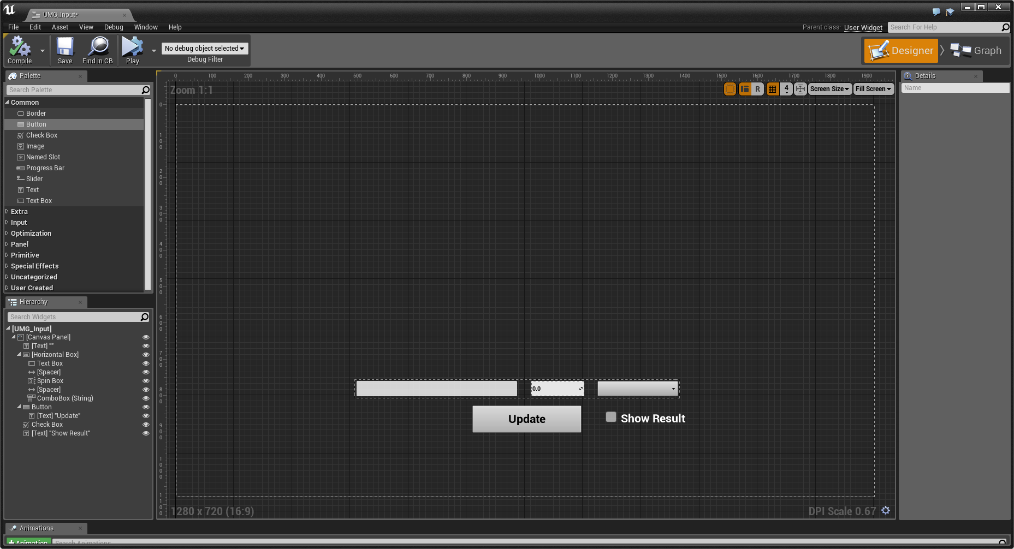
UMG Editor
Unreal Motion Graphics UI Designer (UMG) is a visual UI authoring tool that can be used to create 2D UI elements inside Unreal Engine. These elements can be displayed directly on the screen as well as within the game world or as part of 3D meshes.

Slide 29
UMG is the entry point for UI development in Unreal Engine.
The main building blocks of UMG are Widgets. A Widget can be added to another Widget, which can then be added to a third Widget, creating a hierarchical structure. This method of creation is known as composition. When Widget A is added to Widget B, Widget B is now referred to as the parent of Widget A, which is referred to as the child of Widget B. The parent Widget now can control a range of properties of the child Widget, including where it is rendered, how big it is, and whether or not it is visible.
Not all Widgets can contain other Widgets. To be able to contain another Widget, a Widget must have a Slot. A Widget can have a set number of Slots, or allow any number of Slots. A Slot may allow the child Widget to specify some properties about how it would like to be displayed. What those properties are and how they are used are up to the parent Widget, however.

Slide 30
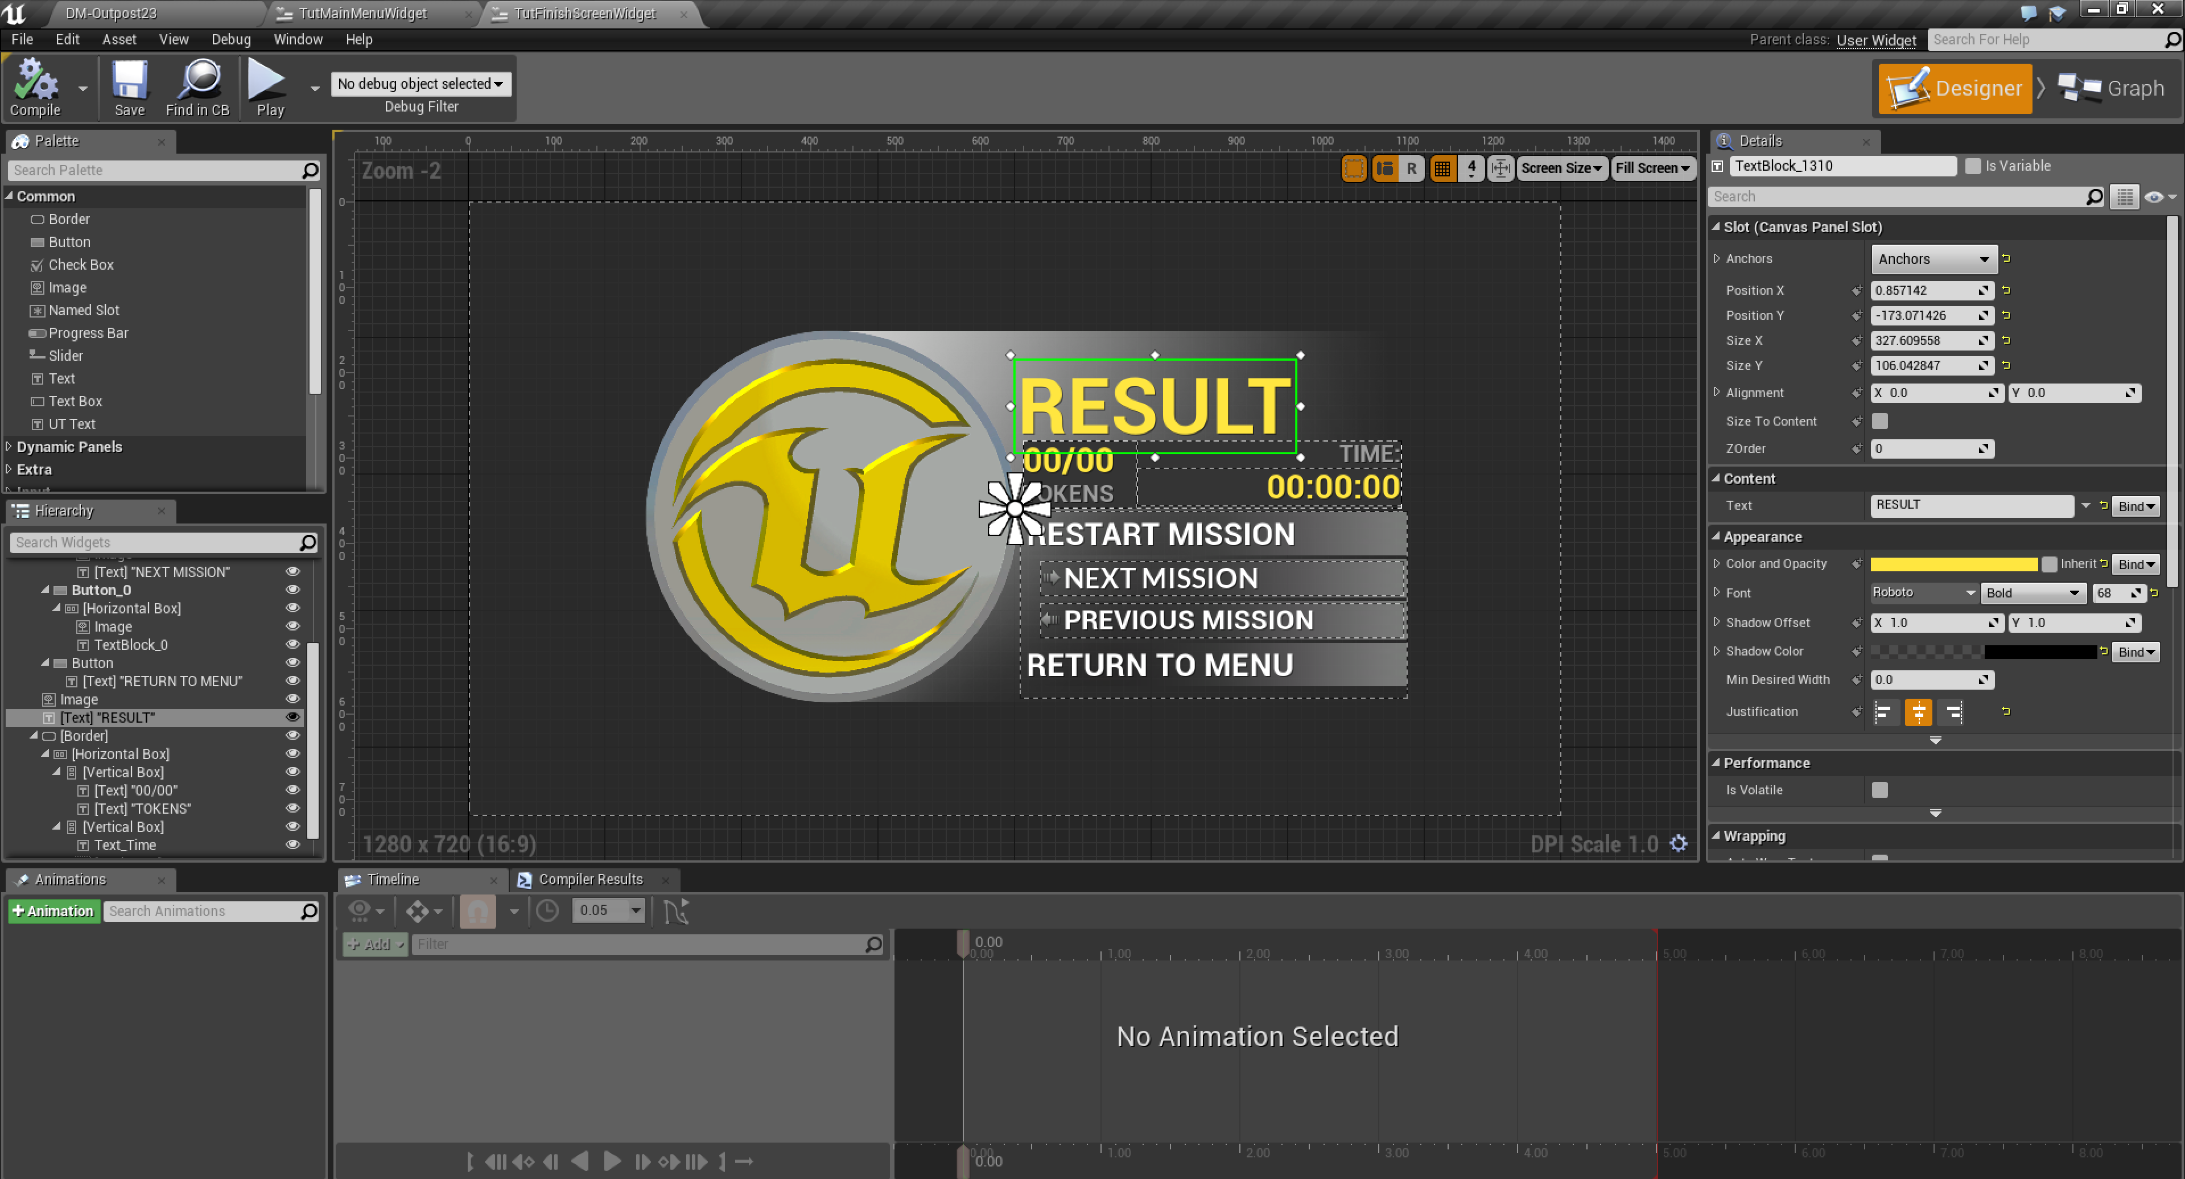
Key Widget Types
There are many types of pre-built Widgets within UMG.
Some Widgets are designed to display information or take information from players, while others are used to help format and control the layout and positions of Widgets.
Panels
Display Widgets
Input Widgets
User Widgets
Examples of UI Widgets in UMG

Slide 31
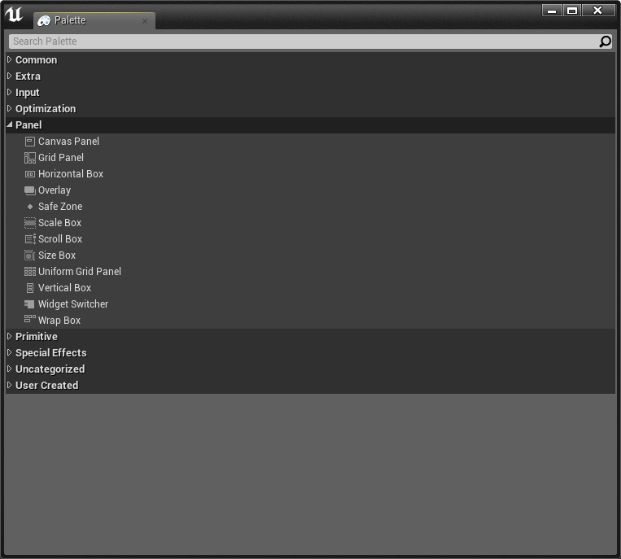
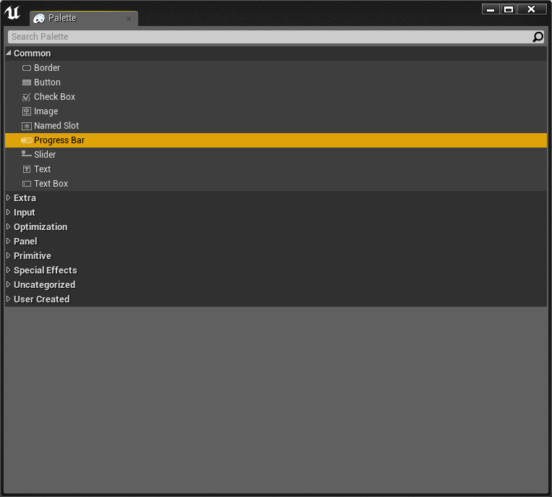
Panel Types
Common Display Widgets
Panels
Display Widgets
Panels control the layout and placement of other Widgets.
Display Widgets, such as Text and Images, display information to the player. There are a range of pre-built Display Widgets to help with more complex ways of displaying information, such as a Progress Bar.

Slide 32
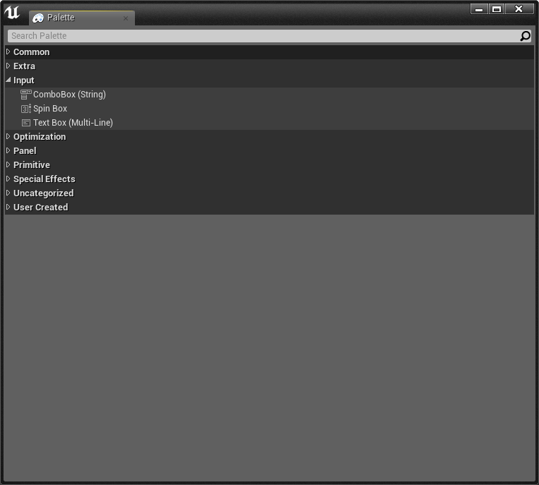
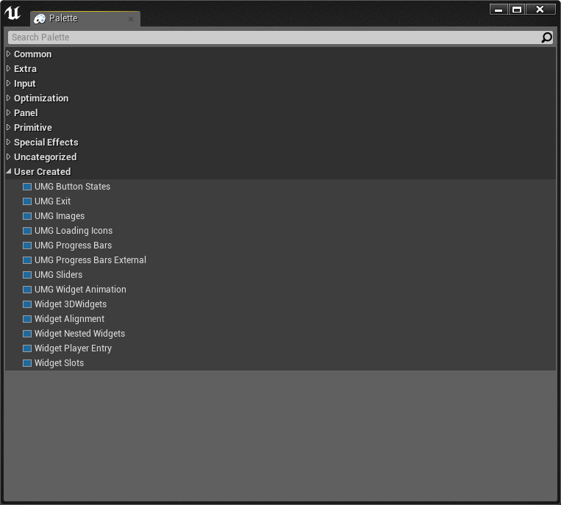
Extended Input Widgets
User Created Widgets
Input Widgets
User Widgets
Input Widgets, such as Buttons, Text Boxes, and Combo Boxes, take user input through the keyboard and mouse.
User Widgets are Widgets made within UMG, which can be reused many times and placed within other User Widgets.

Slide 33
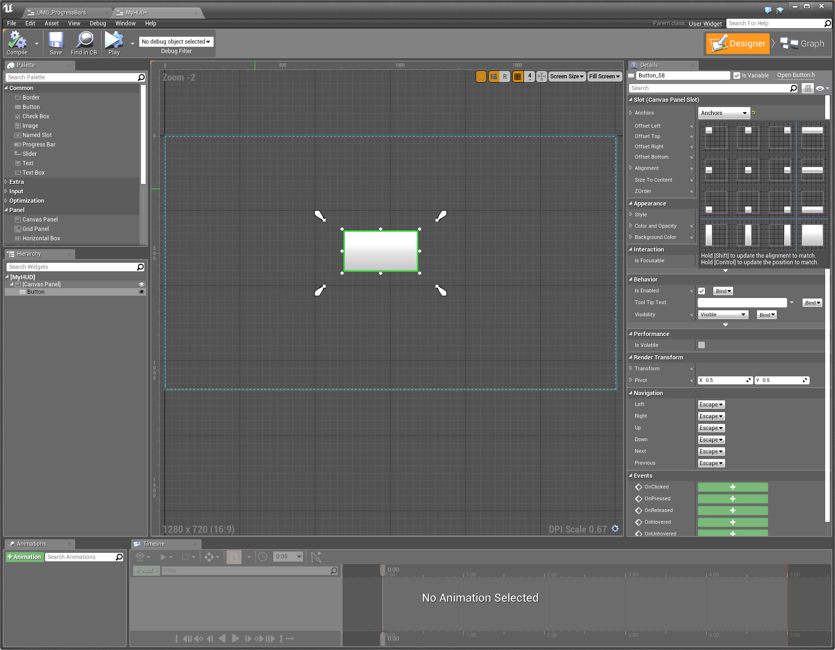
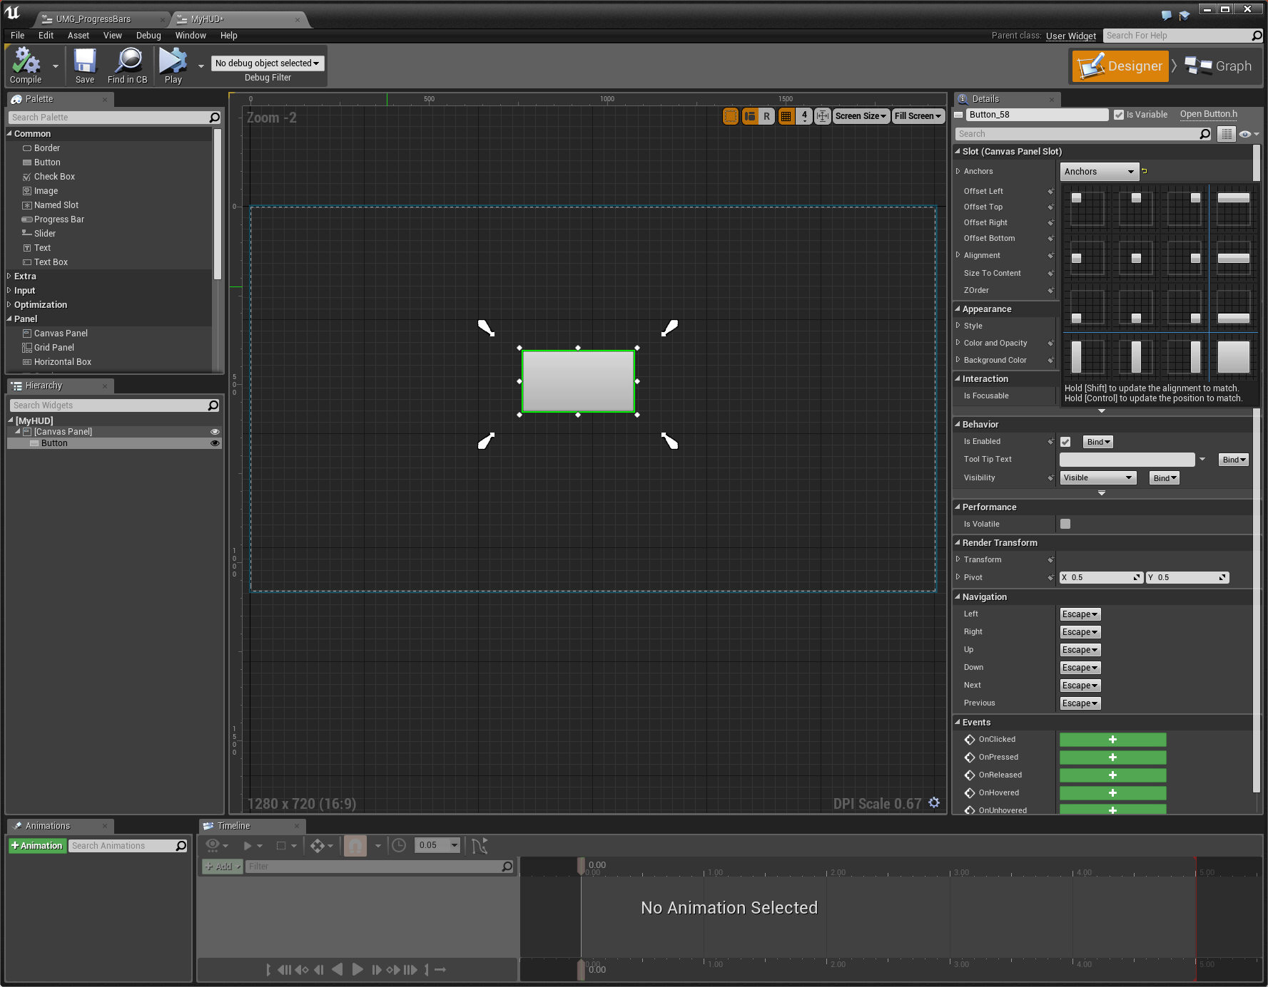
Anchors
Anchors are used to define a UI Widget’s desired location on a Canvas Panel and maintains that position with varying screen sizes. Anchors are normalized where Min(0,0) and Max(0,0) is the upper left corner and Min(1,1) and Max(1,1) is the bottom right corner.
Once you have a Canvas Panel and add other UI Widgets to it, either you can select from a number of preset Anchor positions (typically, selecting one of these should do if you only want to keep your Widget at a specific location) or you can manually set the Anchor position and Min/Max settings as well as applying offsets.
Using Anchors in UMG

Slide 34
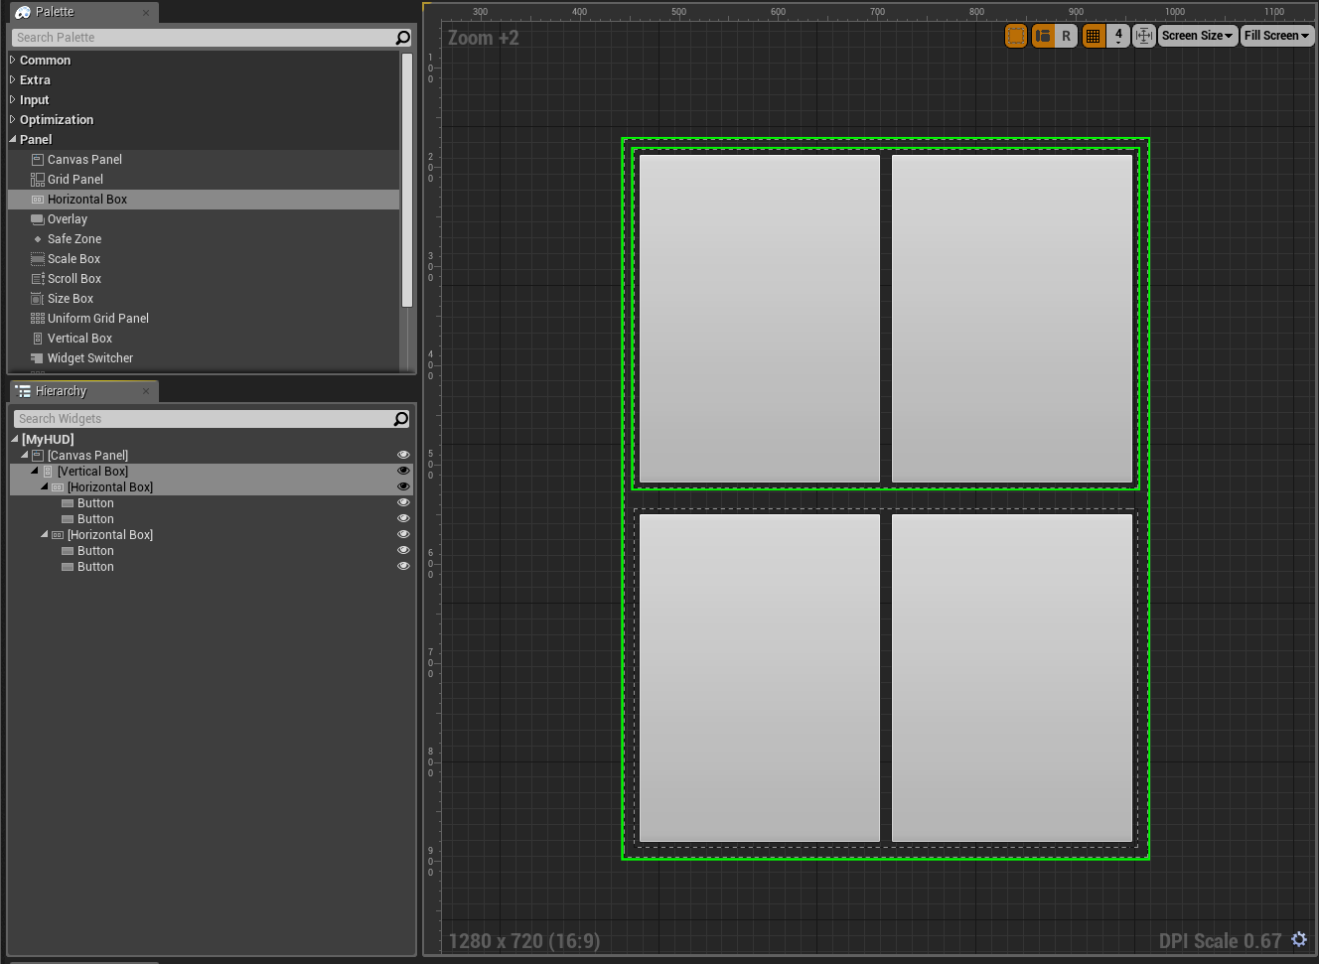
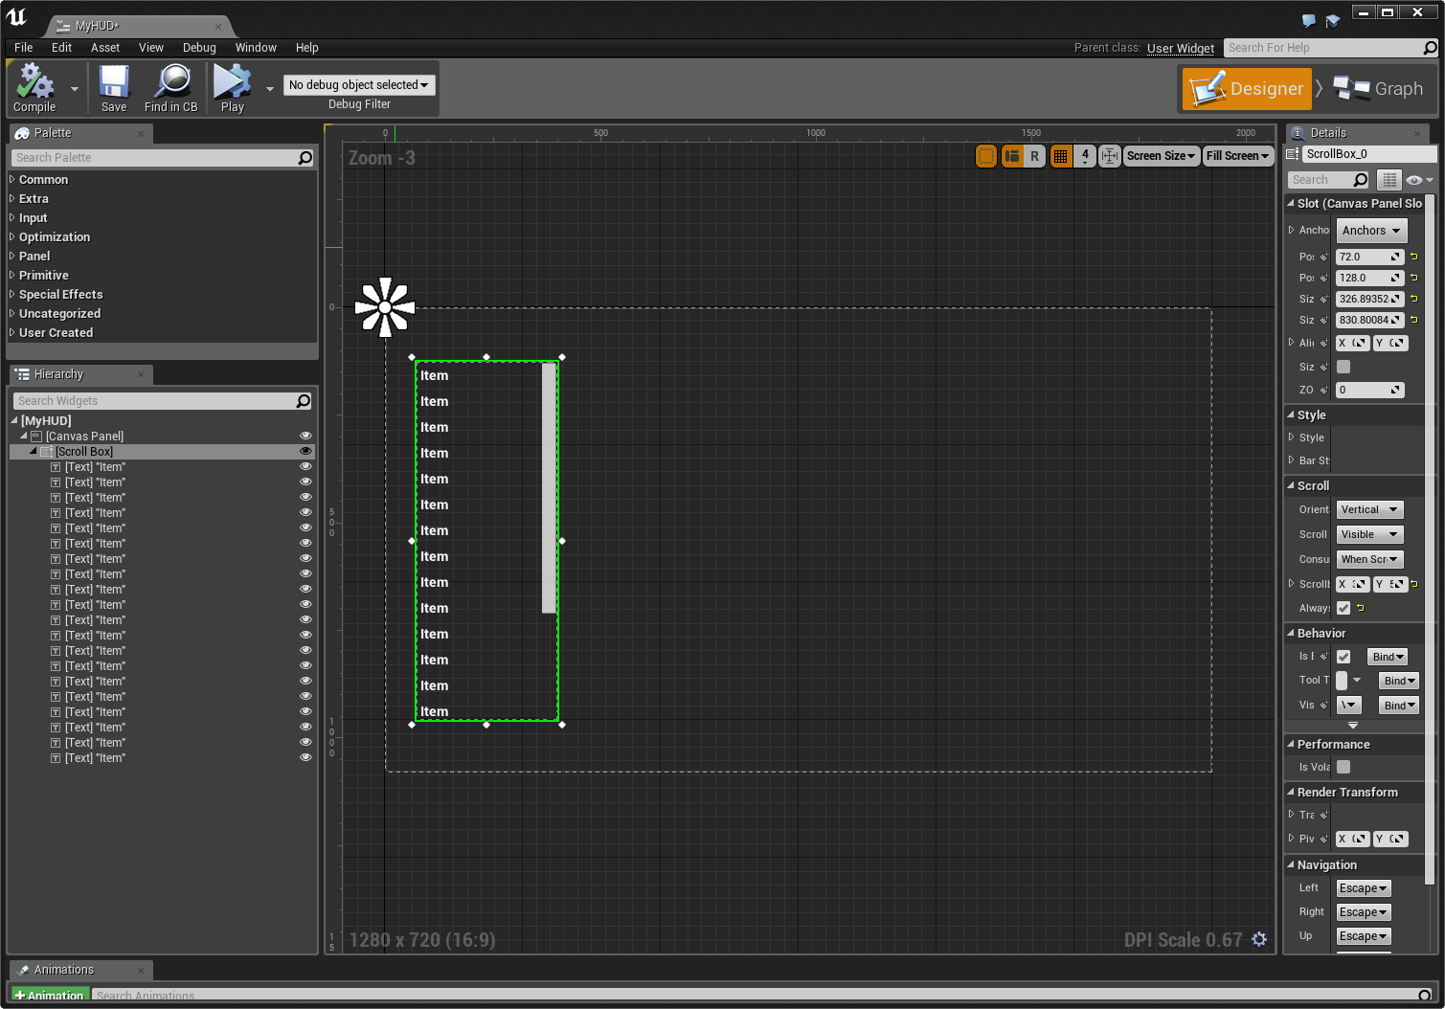
An example of the Horizontal and
Vertical Box Widgets
An example of the Scroll Box Widget
Horizontal/Vertical Box
Scroll Box
A Horizontal/Vertical Box allows child Widgets to be laid out in a flow horizontally/vertically. The order of the flow will match the order the child Widgets are listed in.
A Scroll Box is a collection of Widgets than can scroll horizontally or vertically if the space the child Widgets require exceeds the bounds of the scroll box.

Slide 35
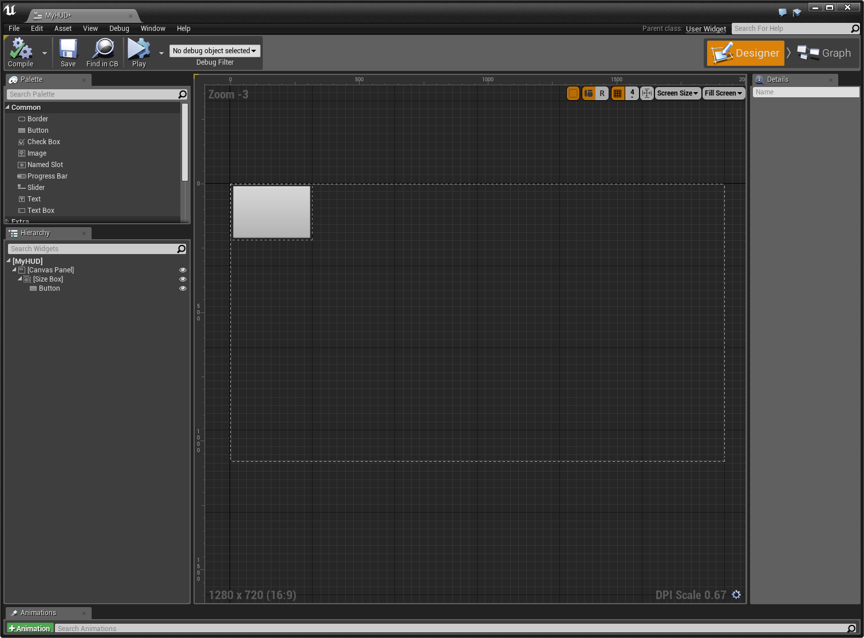
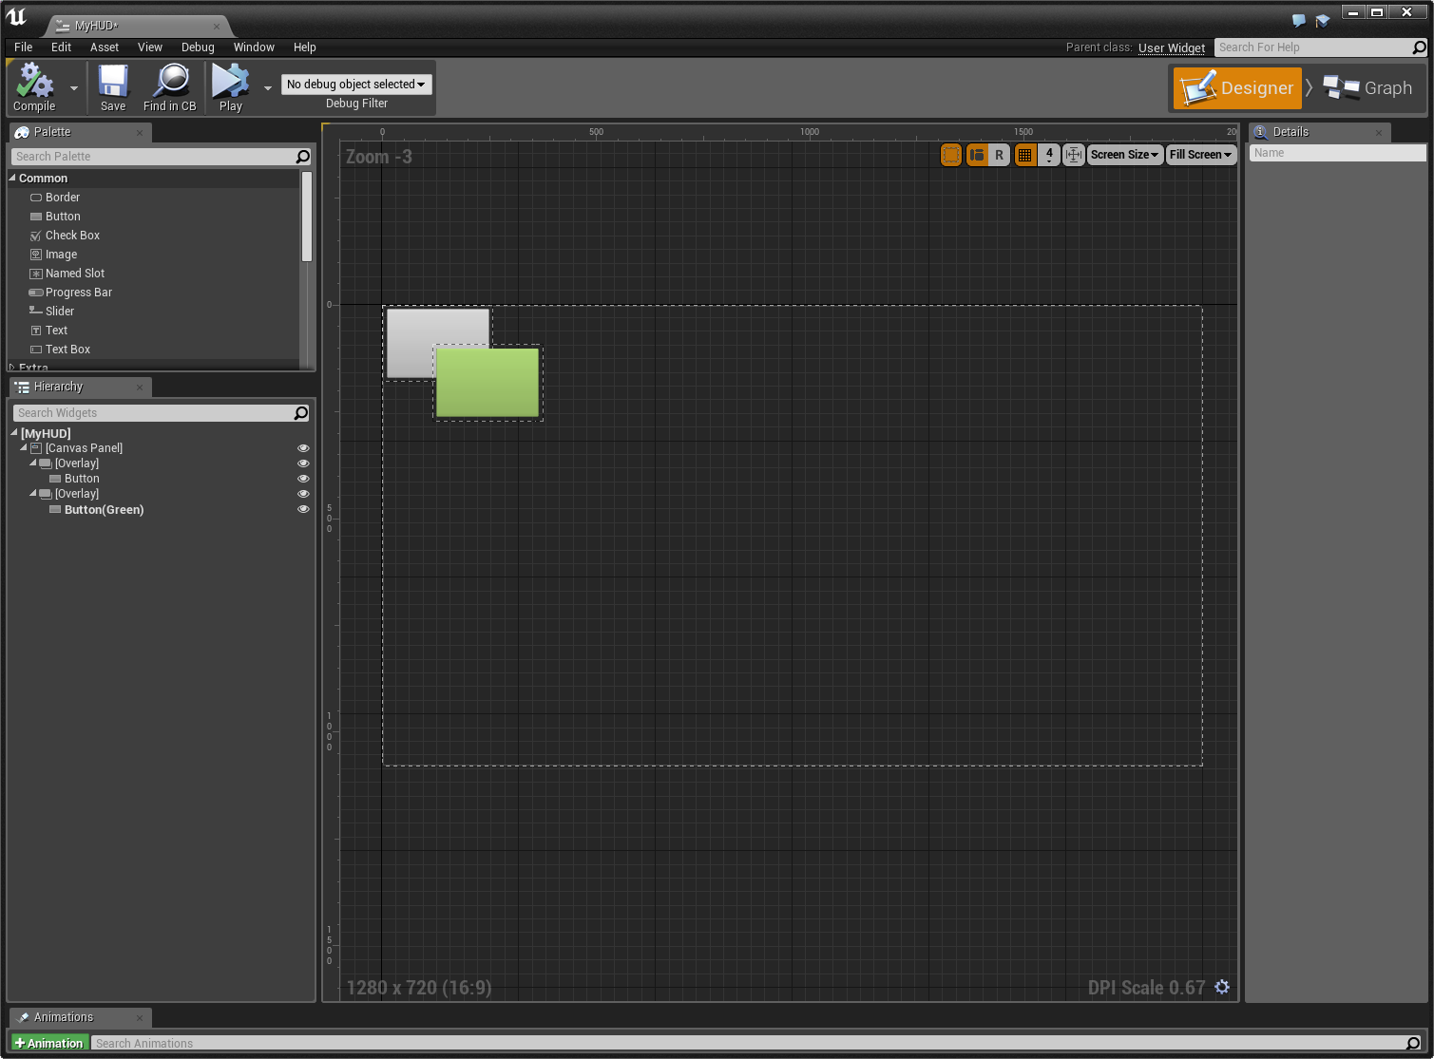
An example of the Size Box Widget
An example of the Overlay Widget
Size Box
Overlay
A Size Box contains only a single Slot and forces the contained Widget in that Slot to have a specific size.
An Overlay allows child Widgets to be stacked on top of each other and uses a simple flow layout for content on each layer.

Slide 36
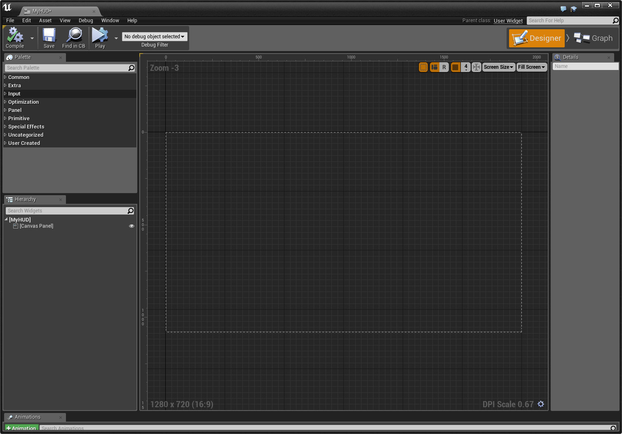
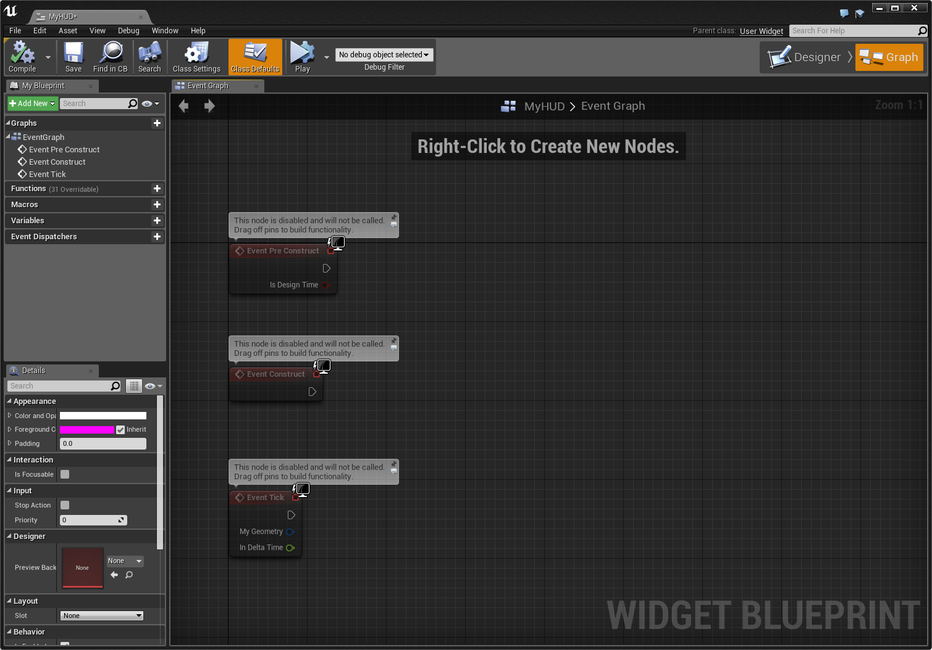
The interface for the UMG Designer
The interface for the UMG Event Graph
Designer
Event Graph
The Designer is where Widgets are composited and configured. It provides a “what you see is what you get” (WYSIWYG) editor.
The Event Graph is a Blueprint editor interface for controlling the behavior of Widgets and reacting to input events from players.

Slide 37
Input between game and UI must be carefully directed and controlled.
Focus indicates what component of the game is allowed to capture the input from controllers, mice, and keyboards. For example, a mouse is often used in a game to control aim; however, it is also often used to control the cursor in a menu. Doing both at the same time would be confusing and problematic for the player, so Focus allows a developer to explicitly set what should be using the input.
Once UMG is given input focus, it is still necessary to be even more specific as to which Widget can accept the input events. For example, you can have multiple text entry boxes; which one should the letters being typed using the keyboard appear in? This sort of focus can be set by the user—that is, clicking on that Widget using a cursor—and it can also be set programmatically.
Once a Widget has focus, it can receive input events and define behavior tied to those events using blueprints in the Graph Editor within the UMG Editor.

Slide 38
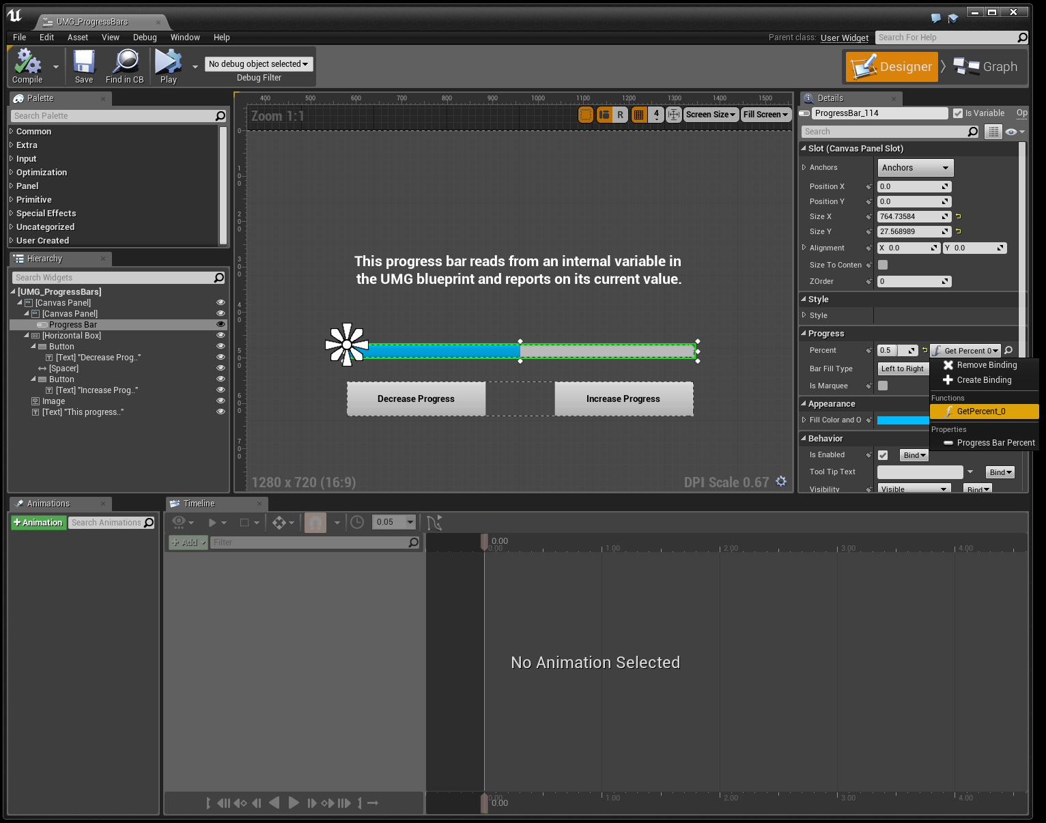
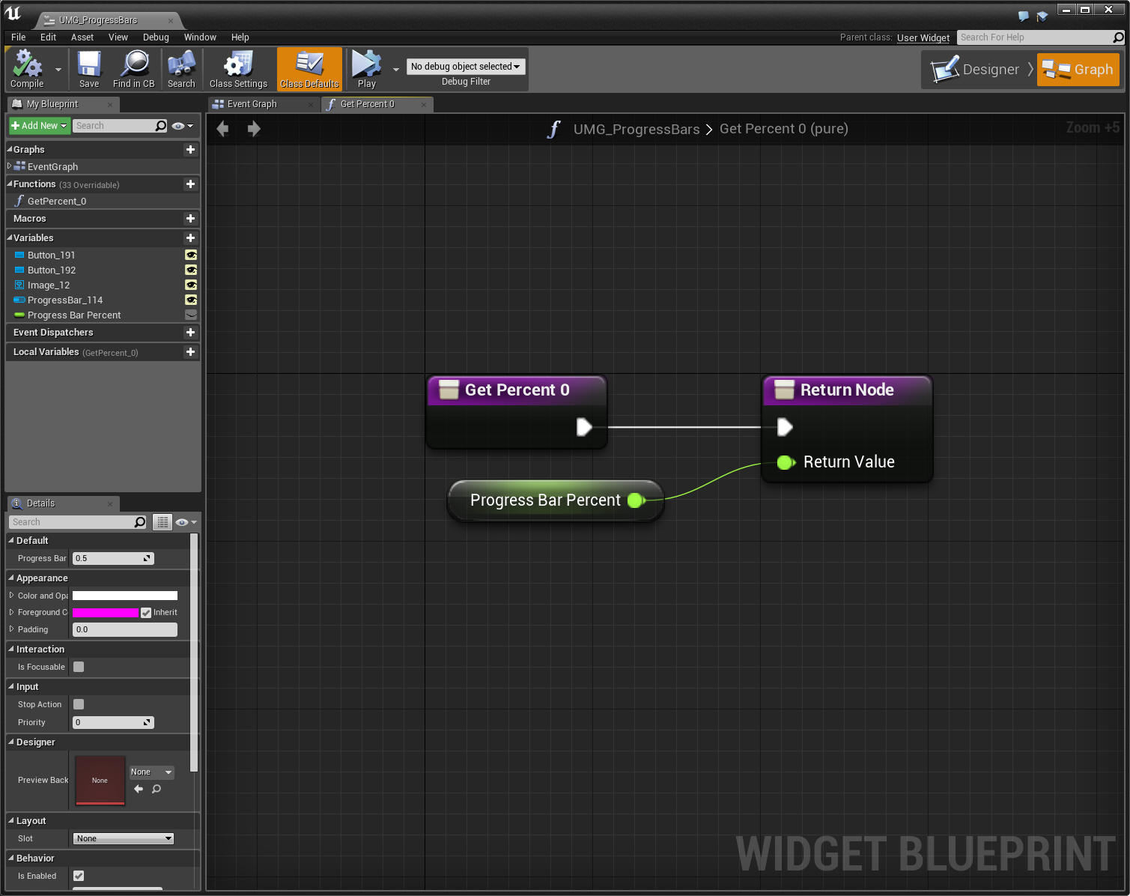
Binding of Properties
One of the most useful aspects inside UMG is the ability to bind properties of your Widgets to functions or variables inside the Blueprint. By binding a Widget’s property to a function or variable in your Blueprint, anytime that function is called or variable is updated, it will be reflected in the Widget.
Property Binding in UMG

Slide 39
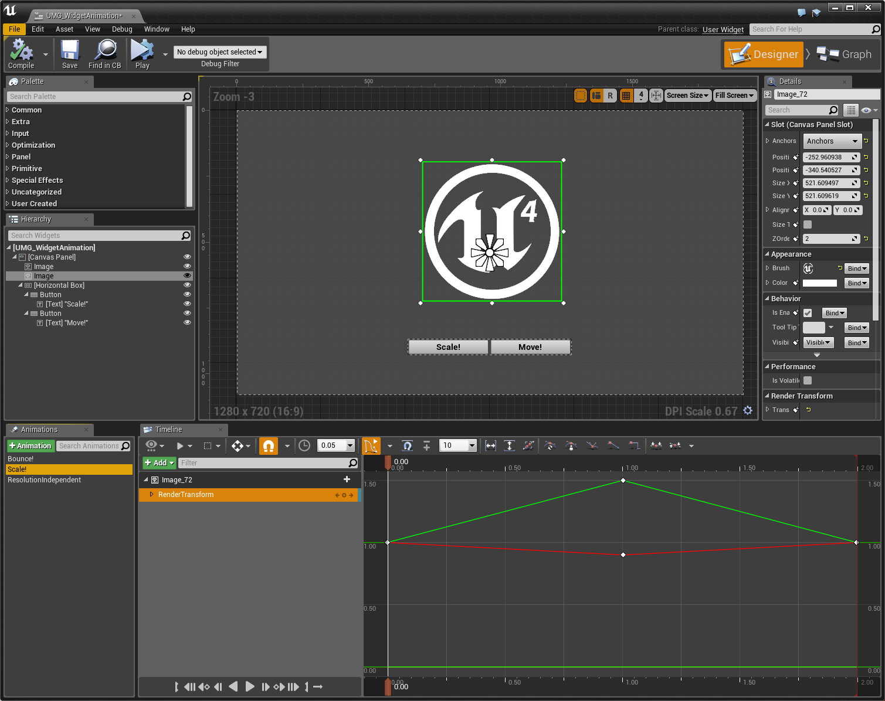
Animation
Located along the bottom of the Widget Blueprint Editor are two windows that allow you to implement and control animations for your UI Widgets.
The first, the Animations window, allows you to create essentially animation tracks, which are used to drive the animation of your Widgets.
The second, the Timeline window, is how an animation is applied to a Widget over time, which is done by placing Keyframes at specified times and then defining how the attached Widget should appear at that Keyframe (this could be size, shape, location, or even coloring options).
Timeline Animation in the UMG Designer

Slide 40
Conclusion
Questions?

